Slide 1
Pipelining and Hazards
Computer Architecture
Lecture 10

Slide 2
MIPS Instruction Format
Pipelining is an implementation technique in which multiple instructions are overlapped in execution.
It is used to make the processor fast.
Pipelining does not reduce the time to complete a single task but increases the throughput and the improvement in the throughput decreases the total time to complete the task.

Slide 3
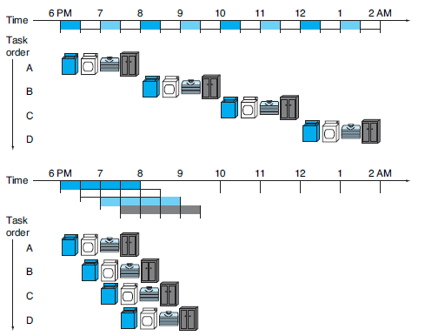
The laundry analogy for pipelining
Four users have dirty clothes to be washed, dried, folded, and put away.
The washer, dryer, “folder,” and “storer” each take 30 minutes for their task.
Sequential laundry takes 8 hours for 4 loads of wash, while pipelined laundry takes just 3.5 hours.

Slide 4
Continue
If all the stages take about the same amount of time and there is enough work to do, then the speed-up due to pipelining is equal to the number of stages in the pipeline, in this case four: washing, drying, folding, and putting away.
It’s only 2.3 times faster in laundry, because we only show 4 loads.
Notice that at the beginning and end of the workload in the pipelined version in in the laundry example, the pipeline is not completely full; this start-up and wind-down affects performance when the number of tasks is not large compared to the number of stages in the pipeline.
If the number of loads is much larger than 4, then the stages will be full most of the time and the increase in throughput will be very close to 4.

Slide 5
MIPS Pipeline
The same principles apply to processors where we pipeline instruction execution. MIPS instructions classically take five steps:
Fetch instruction from memory.
Read registers while decoding the instruction. The regular format of MIPS instructions allows reading and decoding to occur simultaneously.
Execute the operation or calculate an address.
Access an operand in data memory.
Write the result into a register.

Slide 6
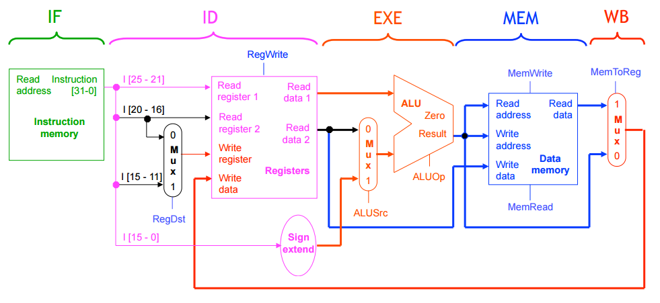
MIPS Pipeline

Slide 7

Graphical representation of the instruction pipeline
  IF: Instruction Fetch stage, with the block representing Instruction Memory.
  ID: Instruction decode/register file read stage, with the drawing showing the register file being read.
  EX: Execution stage; with the drawing representing the ALU.
  MEM: Memory access stage, with the box representing data memory.
  WB: Write-Back stage , with the drawing showing the register file being written.

Slide 8
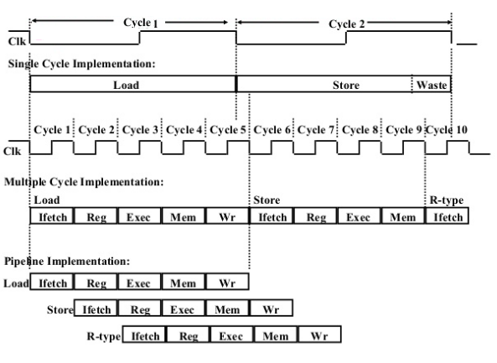
Single Cycle, Multiple Cycle, vs. Pipeline

Slide 9
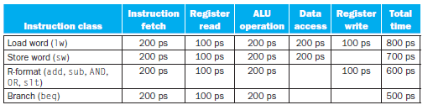
Example

Slide 10
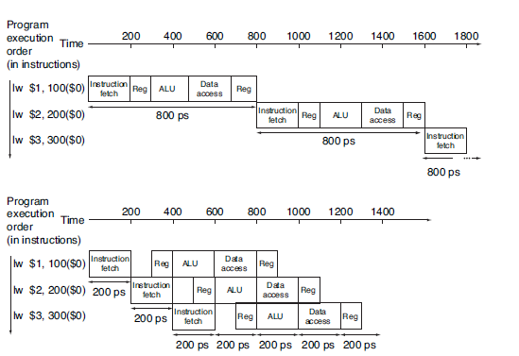
Pipelined vs. Single-Cycle Instruction Execution

Slide 11
Points to know
The single- cycle design must allow for the slowest instruction—in Figure previous slide it is lw—so the time required for every instruction is 800 ps.
Just as the single-cycle design must take the worst-case clock cycle of 800 ps, even though some instructions can be as fast as 500 ps, the pipelined execution clock cycle must have the worst-case clock cycle of 200 ps, even though some stages take only 100 ps.

Slide 12
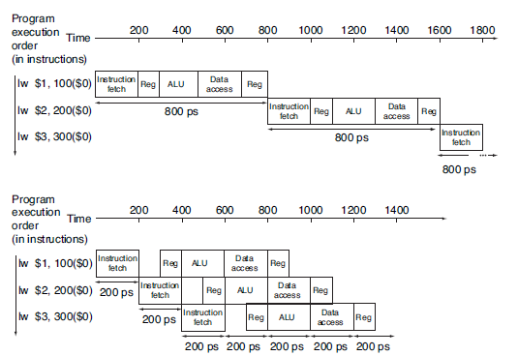
Single-cycle, nonpipelined execution versus pipelined execution
Thus, the time between the first and fourth instructions in the nonpipelined design is 3 × 800 ps or 2400 ps. the time between the first and fourth instructions is 3 × 200 ps or 600 ps.

Slide 13
Pipelined Hazards
  There are situations in pipelining when the next instruction cannot execute in the following clock cycle. These events are called hazards.
  There are three different types of hazards:
  Structural Hazards
  Data Hazards
  Control Hazards

Slide 14
Structural Hazards
A structural hazard occurs when a part of the processor's hardware is needed by two or more instructions at the same time. A canonical example is a single memory unit that is accessed both in the fetch stage where an instruction is retrieved from memory, and the memory stage where data is written and/or read from memory.
They can often be resolved by separating the component into orthogonal units (such as separate caches) or bubbling the pipeline.

Slide 15
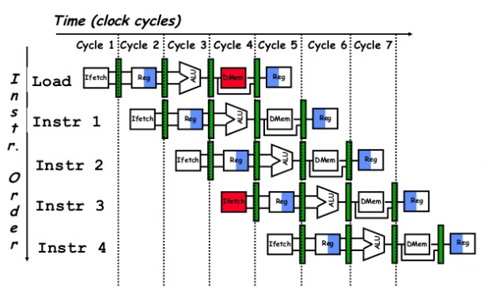
Structural Hazards

Slide 16
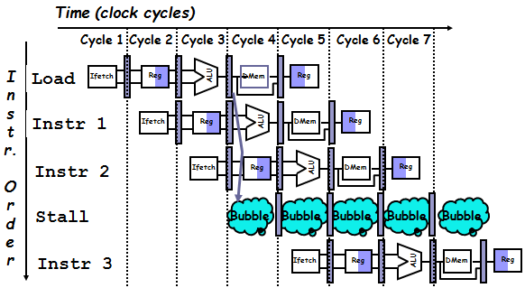
Resolving Structural Hazard
To resolve this, we stall the pipeline for one clock cycle when a data-memory access occurs. The effect of the stall is actually to occupy the resources for that instruction slot.

Slide 17
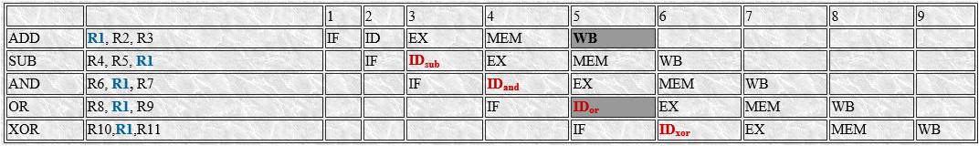
Data Hazards
Data hazards occur when the pipeline must be stalled because one step must wait for another to complete.
In a computer pipeline, data hazards arise from the dependence of one instruction on an earlier one that is still in the pipeline
Consider the pipelined execution of these instructions:

Slide 18
Data Hazards-Continue
All the instructions after the ADD use the result of the ADD instruction (in R1). The ADD instruction writes the value of R1 in the WB stage (shown black), and the SUB instruction reads the value during ID stage (ID_{sub}). This problem is called a data hazard. Unless precautions are taken to prevent it, the SUB instruction will read the wrong value and try to use it.

Slide 19
Data Hazards-Continue
The AND instruction (3rd row) is also affected by this data hazard. The write of R1 of first ADD instruction does not complete until the end of cycle 5 (shown black). Thus, the AND instruction that reads the registers during cycle 4 (ID_{and}) will receive the wrong result.
During OR instruction that reads the register during cycle 5(ID_{or}) will also receive the wrong result.
The XOR instruction operates properly, because its register read occur in cycle 6 after the register write by ADD.

Slide 20
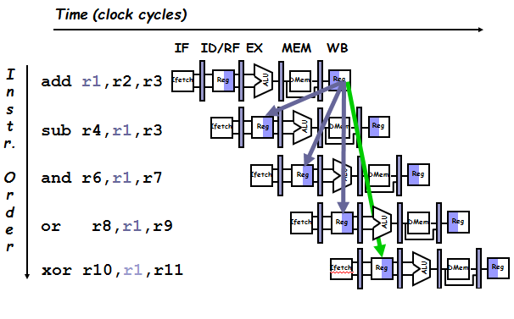
Data Hazards-Continue

